Slide 1
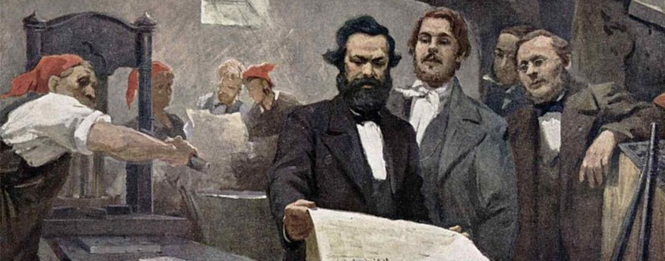

RED LARK WORKSHOP
Website Proposal

Slide 2
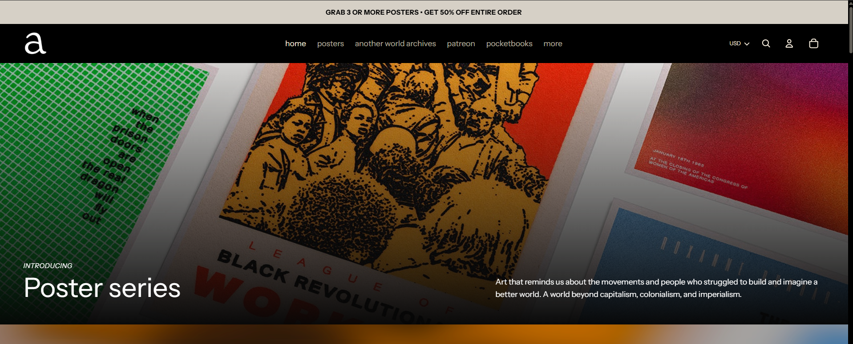
REFERENCE 1
https://anotherworldpress.org/

Slide 3
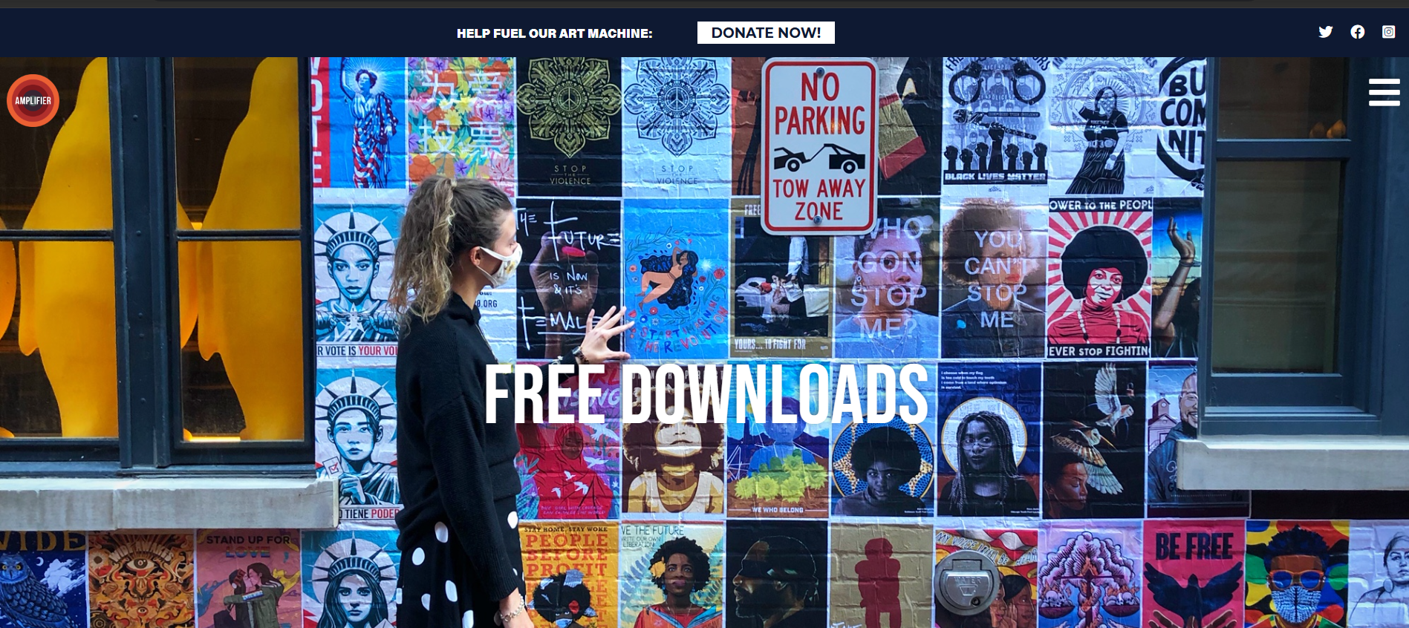
REFERENCE 2
http://amplifier.org/free-downloads/

Slide 4
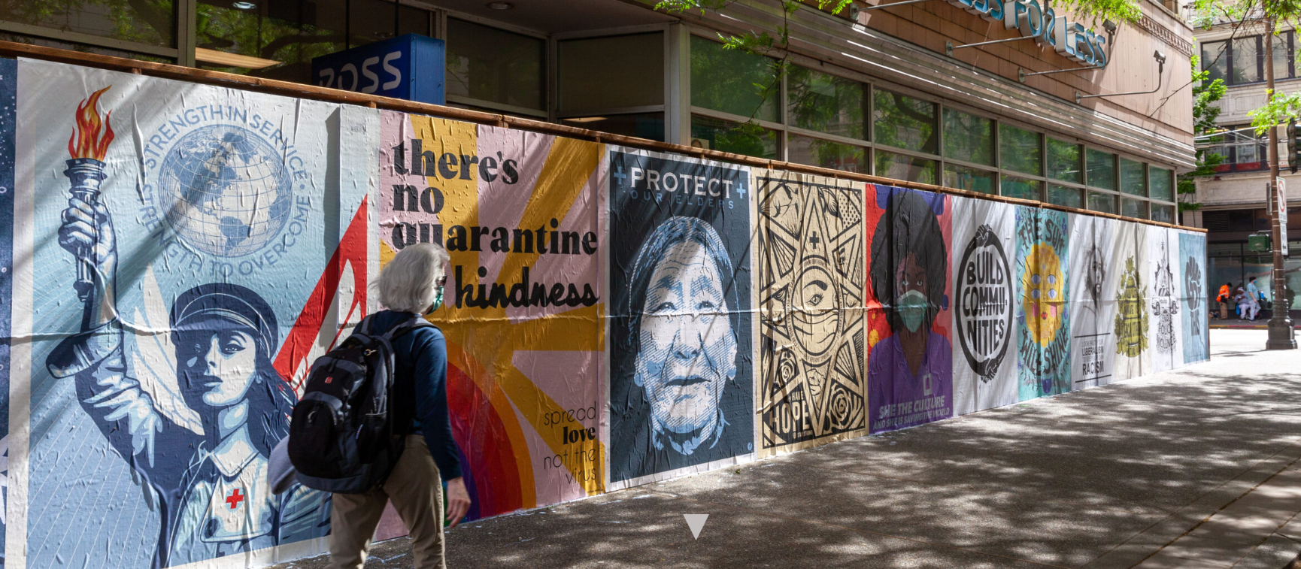

Slide 5
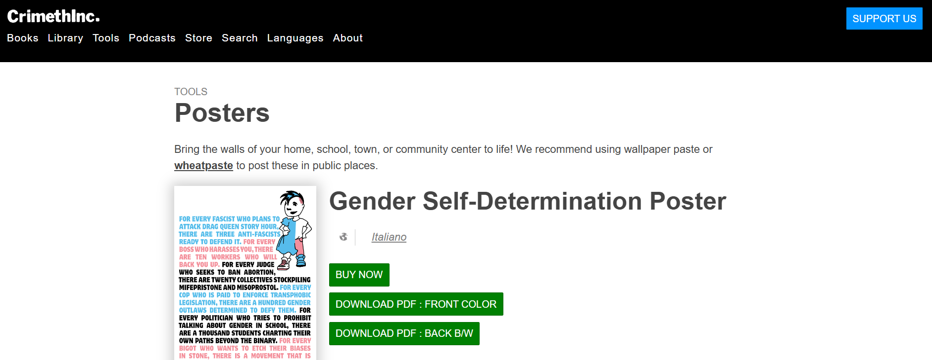
REFERENCE 3
https://crimethinc.com/posters

Slide 6
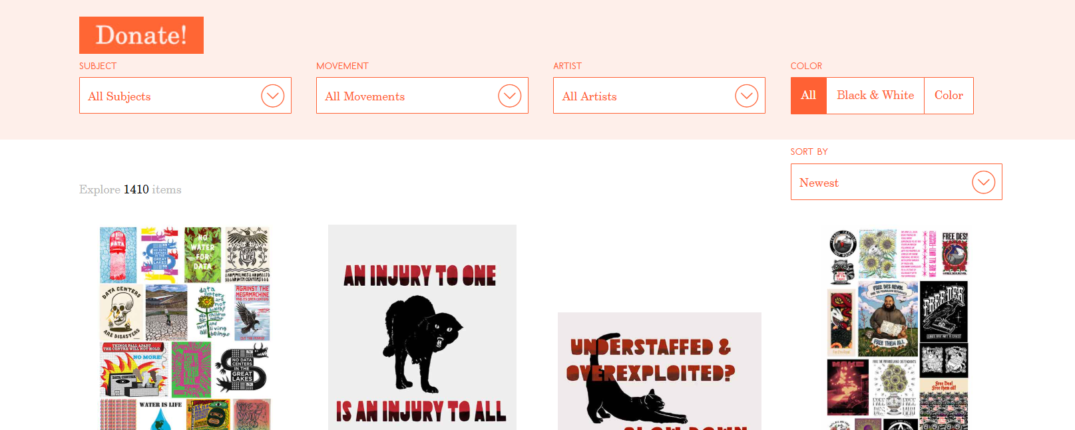
REFERENCE 4
https://justseeds.org/graphics/

Slide 7
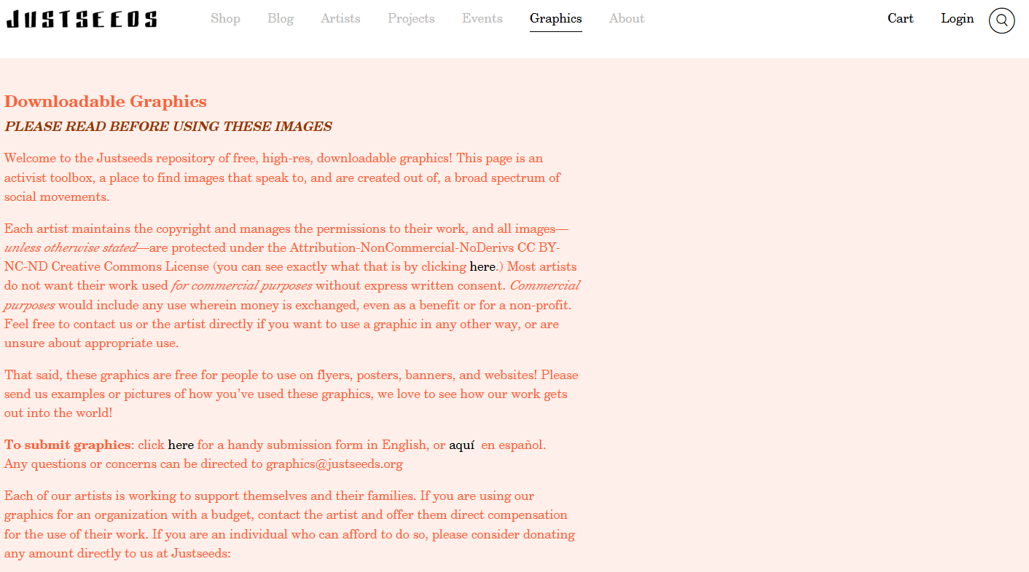
?

Slide 8

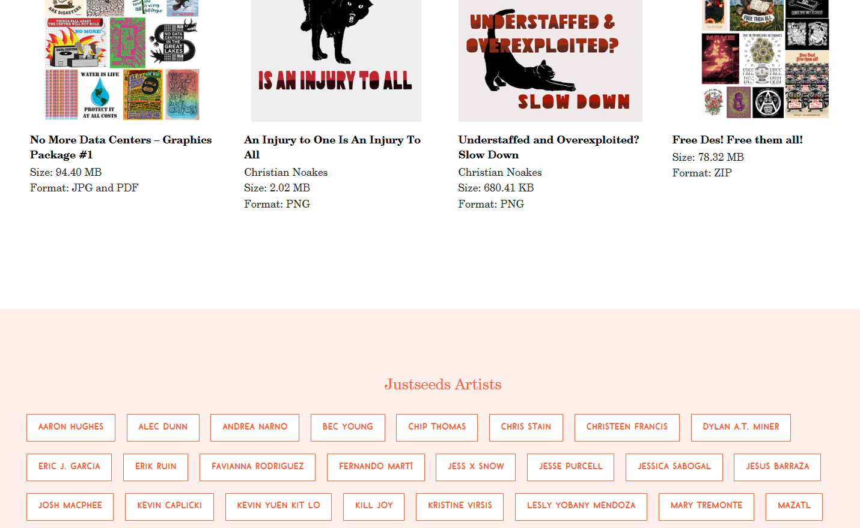

Slide 9
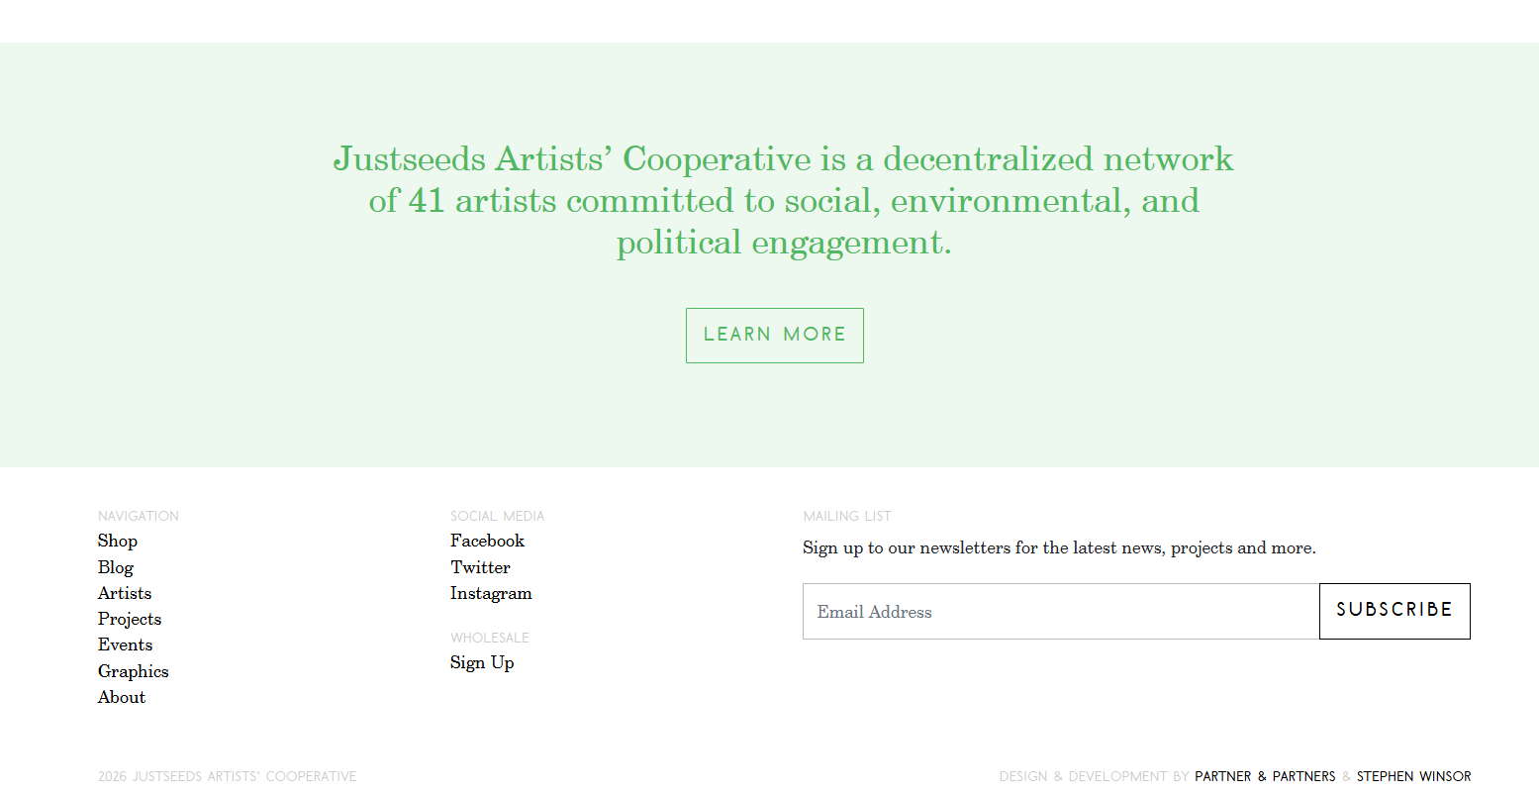

Slide 10
RED LARK WORKSHOP
Other possible names:
The Wet Ink Workshop
The Wet Ink Studio
The Wet Ink Collective
Mirafra Workshop
Mirafra Studio
Mirafra Collective
The Red Lark Workshop
The Red Lark Studio
The Red Lark Collective

Slide 11

1. LANDING PAGE
About: RED LARK WORKSHOP
We are a network of leftist artists and designers in India committed to the principles of the creative commons and the copyleft movement. This non-commercial website is an archive and workshop of creativity for diverse political campaigns—ranging from the fight against fascism and corporate capitalism to the celebration of minority identities and revolutionary histories. The graphics, texts, and images housed here are produced by us, commissioned through our collaborative network, or thoughtfully compiled and adapted from outside sources. We also work as an “advertising” or “design agency” for different social and political movements in India. We strive to credit and promote the original creators, providing their contact details wherever possible. While all the features of this website including the artworks are free to use, visitors are welcome to financially support their favourite artists or donate to the website.
Learn more about us and the website policies.
SEARCH BOX
CHOOSE LANGUAGE:
English
Hindi
Bengali
Malayalam

Slide 12
1. LANDING PAGE
Our objectives:
Fuel and partake in political and social campaigns for an equitable world.
Promote open access and copyleft principles by freely disseminating image and text.
Amplify and archive voices from the margins and forgotten histories.
Champion and support creative activism and non-mainstream artists and writers.
Build a collaborative network and organization of like-minded artists, writers and cultural activists.
Propagate the principles of Marxism-Leninism and work towards bridging and unifying the South Asian left.
SEARCH BOX
CHOOSE LANGUAGE:
English
Hindi
Bengali
Malayalam

Slide 13
1. LANDING PAGE
Our policy on Generative AI:
The Red Lark Workshop was born amidst the recent Gen-Z protests challenging India’s right-wing BJP government and the surge of AI-generated visuals created both for and against the cause. We recognize the inevitability and significance of mass creativity enabled by generative AI, despite the social and ecological harms perpetrated by the Big Tech corporations behind these tools. Because large AI models are trained on massive data averages—often ignoring rare or exceptional samples—we are alarmed by the resulting flood of generic, stereotypical visuals. However well-intentioned, these images frequently border on majoritarian forms of racism, sexism, and ableism. Realizing that human creativity and reflection remain unsurpassed and essential for imagining a better world, we advocate for a thoughtful, minimal use of generative AI rather than a complete boycott. The creative works featured in our archive proudly reflect this principle.
Learn more about us and the website policies.
SEARCH BOX
CHOOSE LANGUAGE:
English
Hindi
Bengali
Malayalam

Slide 14
2
  ALL (Uncategorized)
  Categories
  Adivasis
  Anti-Imperialism
  Anti-War
  BJP-RSS-Hindutva
  CAA-NRC
  Caste and Reservation
  Cockroaches
  Corporates
  Corruption
  Democracy
  Displacement and Migration
  Ecology/Environment/Land
  Farmers
  Fascism
  Feminism and Patriarchy
  Freedom of Speech
  LGBTQI+
  Muslim Identity
  Nationalism
  Palestine
  Political Prisoners
  Revolutionaries
  SIR/Election Commission
  Student Politics
  Unemployment
  Uniform Civil Code
  Workers
  Miscellaneous

Slide 15
2
  ALL (Uncategorized)
  Categories
  Adivasis
  Anti-Imperialism
  Anti-War
  BJP-RSS-Hindutva
  CAA-NRC
  Caste and Reservation
  Cockroaches
  Corporates
  Corruption
  Democracy
  Displacement and Migration
  Ecology/Environment/Land
  Farmers
  Fascism
  Feminism and Patriarchy
  Freedom of Speech
  LGBTQI+
  Muslim Identity
  Nationalism
  Palestine
  Political Prisoners
  Revolutionaries
  SIR/Election Commission
  Student Politics
  Unemployment
  Uniform Civil Code
  Workers
  Miscellaneous

Slide 16
3
Badge
Caricature
Cartoon
Flyer
Meme
Portrait
Poster/Placard
Stencil
Sticker
CREATE YOUR OWN CAMPAIGN MATERIAL
UPLOAD YOUR OWN ART AND DESIGN

Slide 17
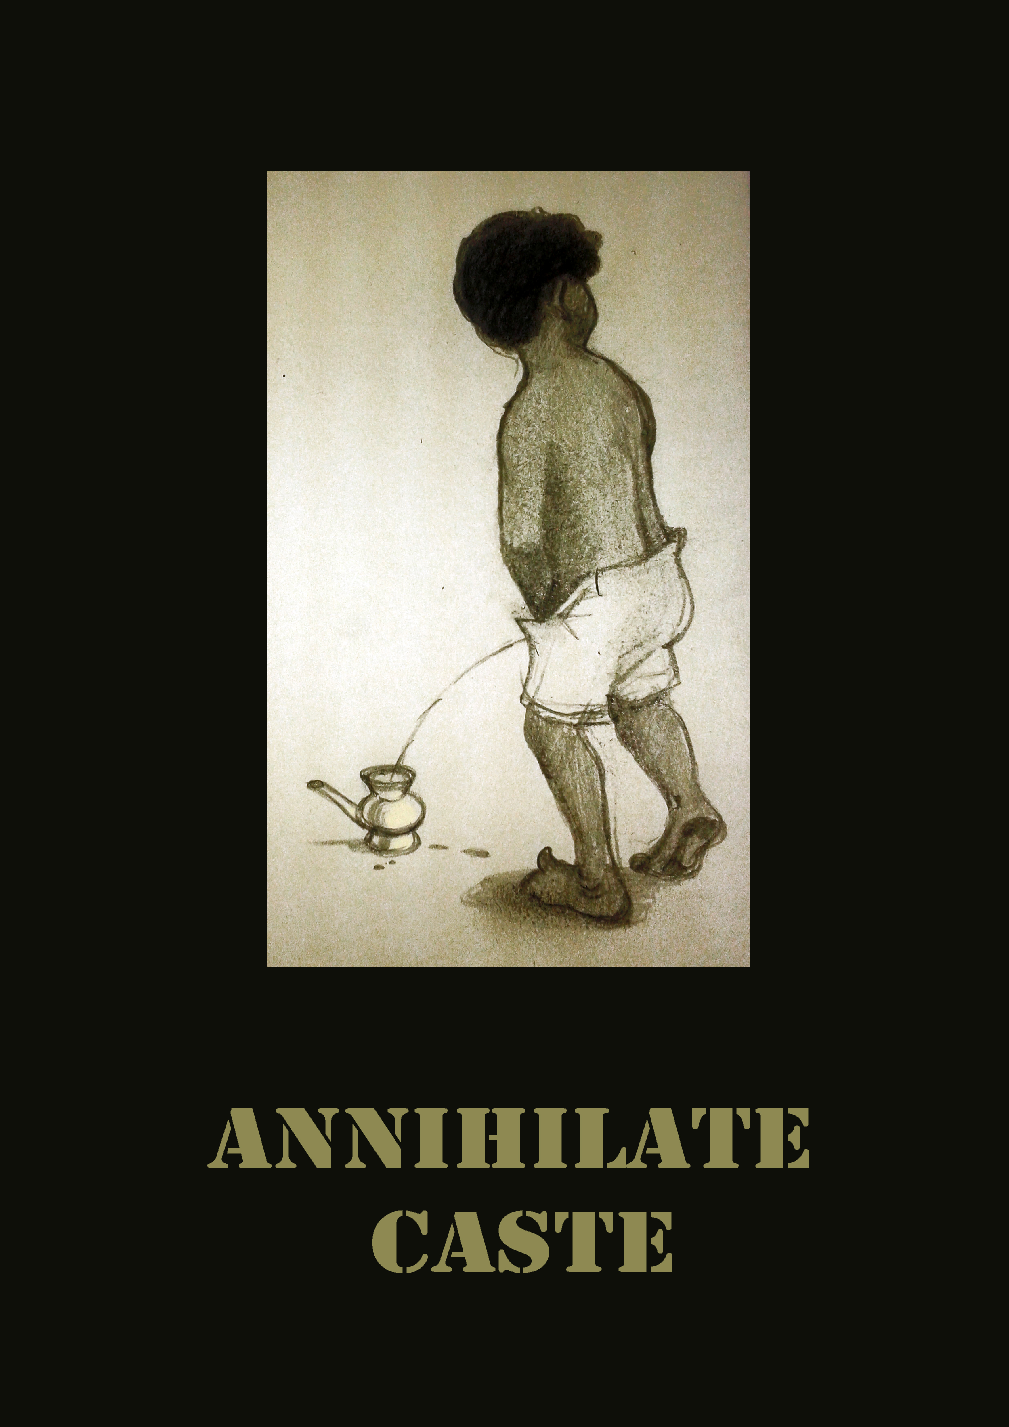
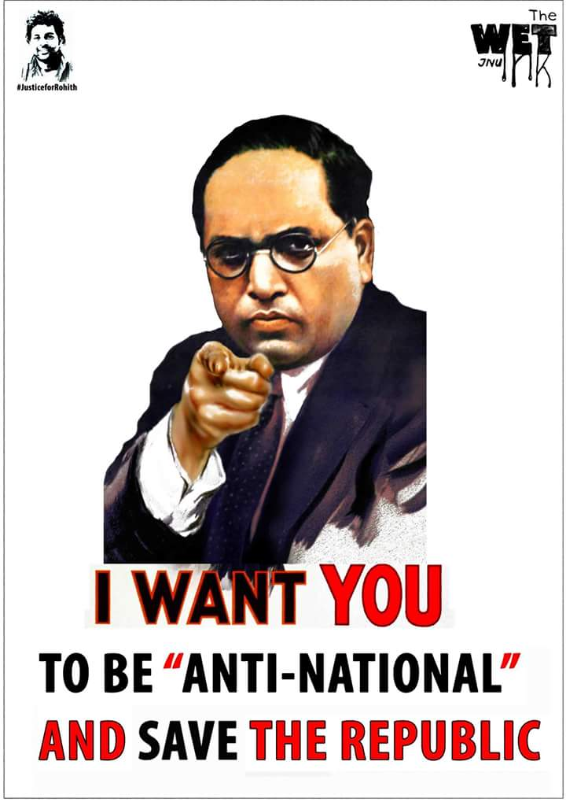
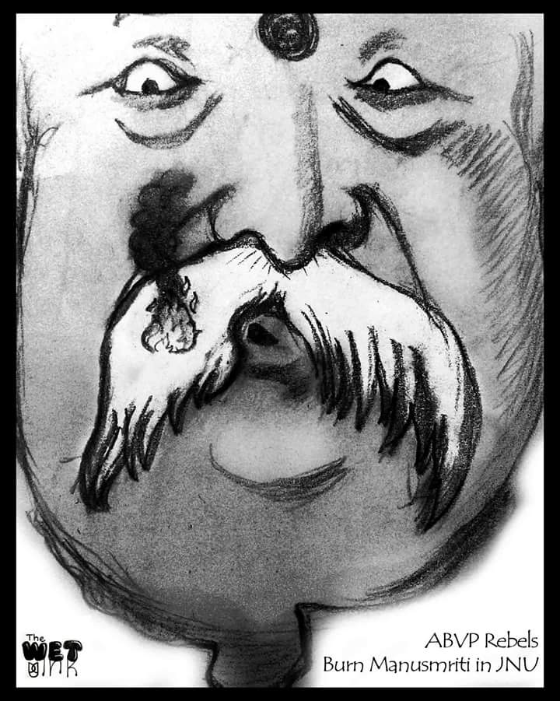
3
3.1
Badge
Caricature
Cartoon
Flyer
Meme
Portrait
Poster/Placard
Stencil
Sticker
CREATE YOUR OWN CAMPAIGN MATERIAL
UPLOAD YOUR OWN ART AND DESIGN
(Sort by newest)

Slide 18
3
3.1
3.2
Badge
Caricature
Cartoon
Flyer
Meme
Portrait
Poster/Placard
Stencil
Sticker
CREATE YOUR OWN CAMPAIGN MATERIAL
UPLOAD YOUR OWN ART AND DESIGN
(Sort by newest)
Image code: 1a
Caption code: 2c
Format: JPEG
Size: A4/A2, Resolution: 300 DPI
Artist: The Wet Ink Workshop
Contact: ….@gmail.com
Contribute: ….@okaxis
More by the artist
Tags: Caste and Reservation, BJP-RSS-Hindutva, Democracy, Ambedkar
DOWNLOAD FOR FREE

Slide 19
3
3.1
Badge
Meme
Poster/Placard
Stencil
Sticker
Choose format
Badge
Caricature
Cartoon
Flyer
Meme
Portrait
Poster/Placard
Stencil
Sticker
CREATE YOUR OWN CAMPAIGN MATERIAL
UPLOAD YOUR OWN ART AND DESIGN

Slide 20
3
3.1
Badge
Meme
Poster/Placard
Stencil
Sticker
Choose format
Badge
Caricature
Cartoon
Flyer
Meme
Portrait
Poster/Placard
Stencil
Sticker
CREATE YOUR OWN CAMPAIGN MATERIAL
UPLOAD YOUR OWN ART AND DESIGN
3.2
Image Code
Caption Code
(Featured tools:
Rotate and adjust size and colour of text and image.)
Download for Free
Note: Instructions for printout and use

Slide 21
3
Badge
Caricature
Cartoon
Meme
Portrait
Poster/Placard
Stencil
Sticker
Zine
3.1
Badge
Caricature
Cartoon
Flyer
Meme
Portrait
Poster/Placard
Stencil
Sticker
CREATE YOUR OWN CAMPAIGN MATERIAL
UPLOAD YOUR OWN ART AND DESIGN
Choose format
Note: Your artwork will be featured after the website admin review

Slide 22
3
Badge
Caricature
Cartoon
Meme
Portrait
Poster/Placard
Stencil
Sticker
Zine
3.1
Badge
Caricature
Cartoon
Flyer
Meme
Portrait
Poster/Placard
Stencil
Sticker
CREATE YOUR OWN CAMPAIGN MATERIAL
UPLOAD YOUR OWN ART AND DESIGN
Choose format
3.2
Fill the details: (Recommended but not mandatory)
Artist name:
Contact:
UPI ID:
Format: JPEG
Size: A4/A2, Resolution: 300 DPI
Upload
Note: Your artwork will be featured after the website admin review

Slide 23
FURTHER POINTS
Strengthening the Team:
Design Team (InDesign, Adobe Illustrator and Photoshop, etc.)
Legal Team (Copyright)
Networking with Designers and Artists

Slide 24
FURTHER POINTS
Regarding the website:
Language Barrier?
Login/Sign-in?

Slide 25
FURTHER POINTS
Regarding the website:
Language Barrier?
Login/Sign-in?
Blog? – Introducing techniques of printing and distribution, interview with featured artists, articles on art and activism, photo-gallery of the creatives in use, etc.

Slide 26
FURTHER POINTS
Regarding the website:
Language Barrier?
Login/Sign-in?
Blog? – Introducing techniques of printing and distribution, interview with featured artists, articles on art and activism, photo-gallery of the creatives in use, etc.
AI-policy?
Alternative: Shifting the stress from “Workshop/Studio” to “Archive/Repository”?

